Slide 1
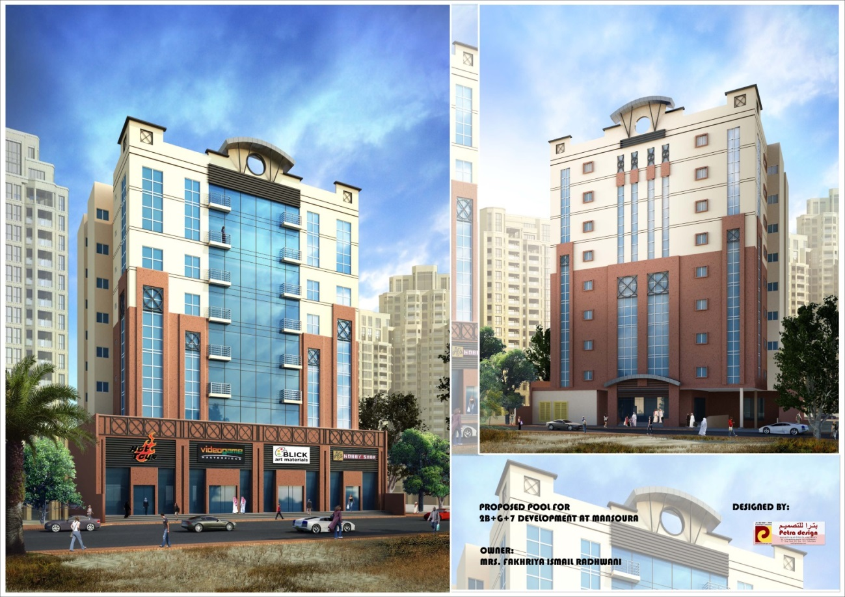
2B + G + M + 7 Mansoura Development Doha, Qatar
Penn State Architectural Engineering Senior Capstone Project
Ramy Labna | Construction Option | Advisor: Prof Ray Sowers

Slide 2
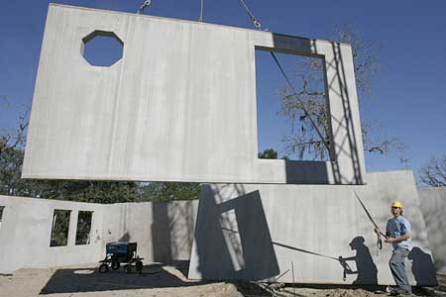
Ramy Labna | Construction Option
Project Overview
2B + G + M + 7 Mansoura Development
OUTLINE
Project Background
Analysis 1: Construction Precast Vs. Cast in Place Concrete
Analysis 2: Comparison of Construction Practices between US & Qatar
Analysis 3: Field Labor Management & Alteration
Conclusion
Analysis 1: Precast Vs. Cast in Place
Photo Courtesy of www.mcentirerentalproperties.com
Analysis 2: Comparison of Construction Practices between US & Qatar
Analysis 3: Field Labor Management & Alteration
Photo Courtesy of www.beautifulholidays.com.au
Photo Courtesy of www.cutcaster.com

Slide 3
Ramy Labna | Construction Option
Project Background
2B + G + M + 7 Mansoura Development
OUTLINE
Project Background
Analysis 1: Construction Precast Vs. Cast in Place Concrete
Analysis 2: Comparison of Construction Practices between US & Qatar
Analysis 3: Field Labor Management & Alteration
Conclusion
Building Name | 2B + G + M + 7 Development at Mansoura
Size | 106,000 Gross Square Feet
No. of Stories | 9 stories above grade & 2 stories below
Dates of Construction | April 15, 2013 – April 15, 2015
Cost of overall Project | $7M
Project Delivery Method | Design-Bid-Build
Payment Method | Lump Sum Method
Owner| Fakhriya Radhwani
Architect | Petra Design
Contractor | Commitment Construction
PROJECT INFO

Slide 4
Ramy Labna | Construction Option
Analysis 1: Construction of Precast Vs. Cast in Place Construction
2B + G + M + 7 Mansoura Development
OUTLINE
Project Background
Analysis 1: Construction Precast Vs. Cast in Place Concrete
Introduction
Design
Manufacturing & Quality
Delivery & Erection
Cost Impact
Schedule Impacts
Mechanical Breadth
Conclusions & Recommendations
Analysis 2: Comparison of Construction Practices between US & Qatar
Analysis 3: Field Labor Management & Alteration
Conclusion
Opportunity Identification
Schedule & Construction acceleration scenarios
Reduction of Schedule with the use of Precast Panels
Existing System
Cast in Place Concrete – Entire Structure
Concrete transported in unhardened state as ready-mix
Used for its long-term durability & structural support
Current superstructure schedule takes approximately 13 months

Slide 5
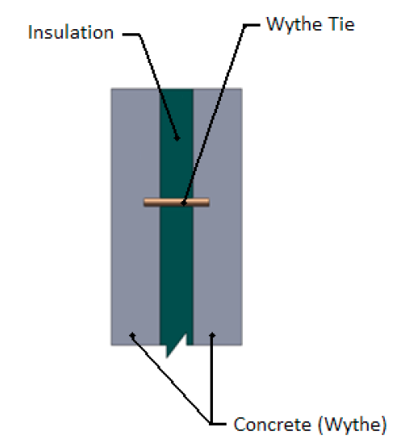
Ramy Labna | Construction Option
Analysis 1: Construction of Precast Vs. Cast in Place Concrete
2B + G + M + 7 Mansoura Development
OUTLINE
Project Background
Analysis 1: Construction Precast Vs. Cast in Place Concrete
Introduction
Design
Manufacturing & Quality
Delivery & Erection
Cost Impact
Schedule Impacts
Mechanical Breadth
Conclusions & Recommendations
Analysis 2: Comparison of Construction Practices between US & Qatar
Analysis 3: Field Labor Management & Alteration
Conclusion
Current Design
10” of concrete with no insulation
Paint Finish
Proposed Design
2” of Rigid Insulation
Sandwiched by two 3” Concrete panels
Paint Finish
Existing System
Cast in Place Concrete – Entire Structure
Concrete transported in unhardened state as ready-mix
Used for its long-term durability & structural support
Proposed System
Precast Concrete Exterior Wall Panels
Floor Beams & Columns and Slabs are cast in place
Photo Courtesy of www.enconunited.com

Slide 6
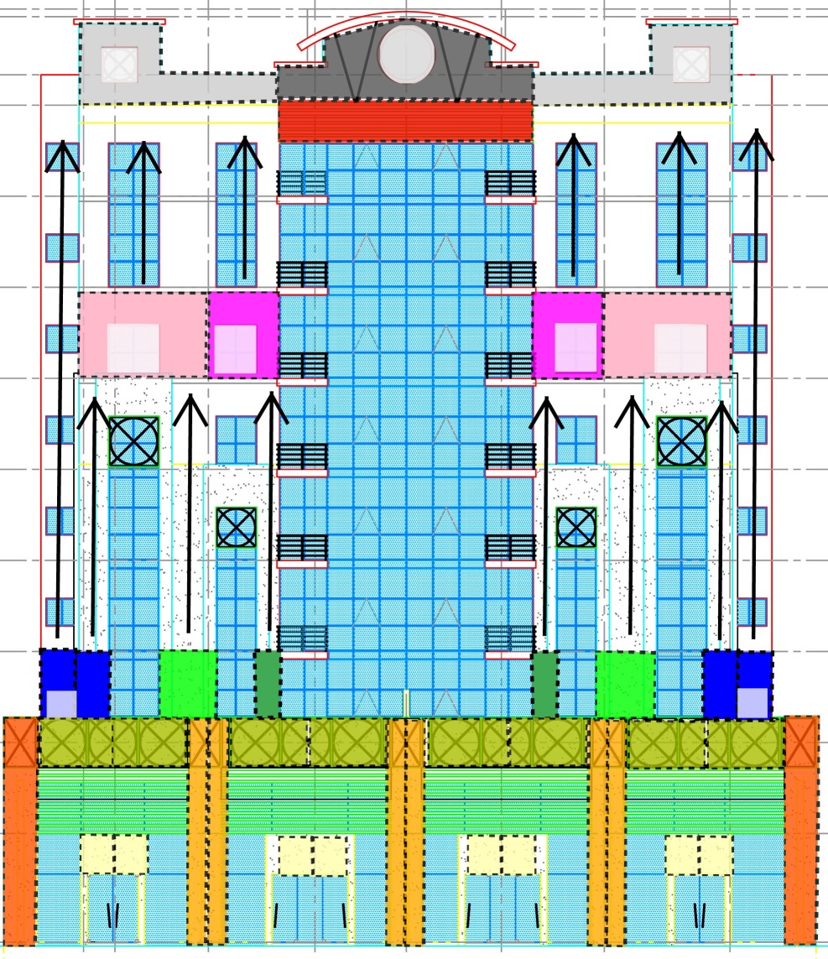
Ramy Labna | Construction Option
Analysis 1: Construction of Precast Vs. Cast in Place Concrete
2B + G + M + 7 Mansoura Development
OUTLINE
Project Background
Analysis 1: Construction Precast Vs. Cast in Place Concrete
Introduction
Design
Manufacturing & Quality
Delivery & Erection
Cost Impact
Schedule Impacts
Mechanical Breadth
Conclusions & Recommendations
Analysis 2: Comparison of Construction Practices between US & Qatar
Analysis 3: Field Labor Management & Alteration
Conclusion
Design
Aim: To reduce amount of panels used
Panels designed to fit between each floor beams
Repetitive floors (1-7)
Same concrete mold can be used for multiple panels
Total of 33 Different Panels
West & East façades are completely identical
North Elevation

Slide 7
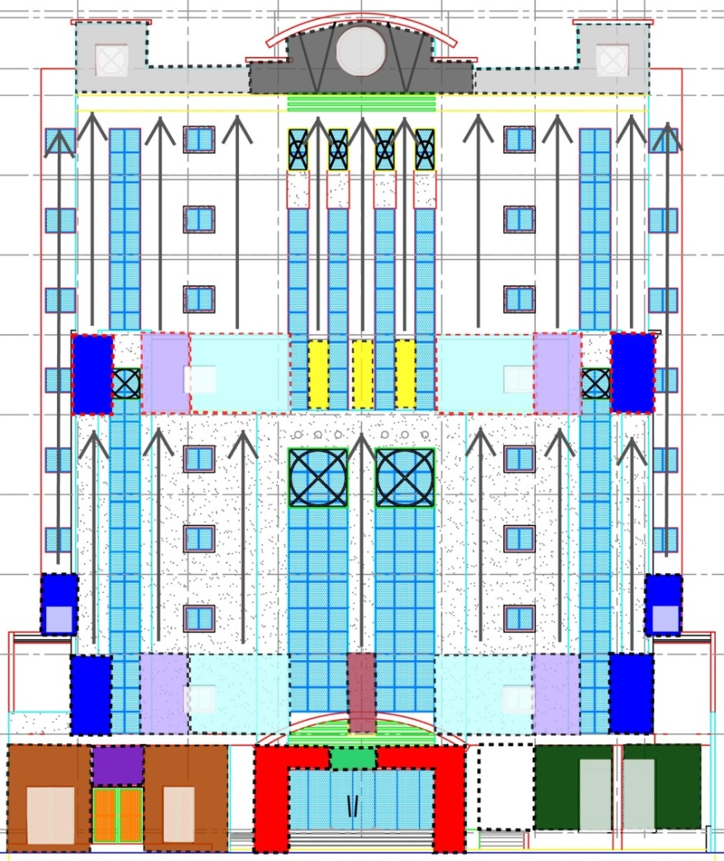
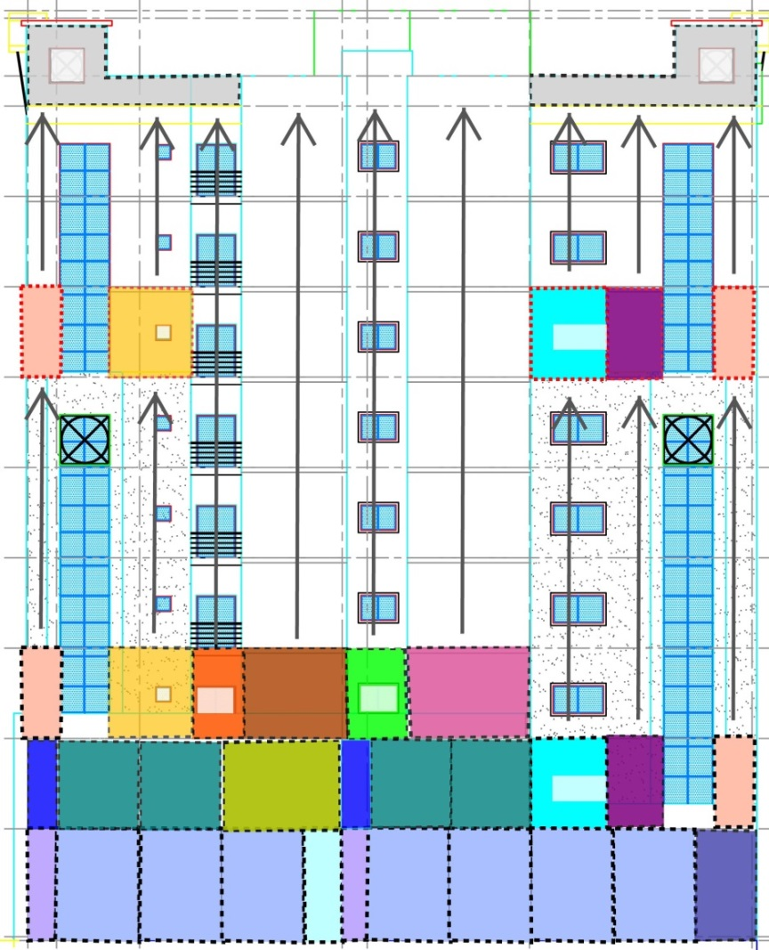
Ramy Labna | Construction Option
Analysis 1: Construction of Precast Vs. Cast in Place Concrete
2B + G + M + 7 Mansoura Development
OUTLINE
Project Background
Analysis 1: Construction Precast Vs. Cast in Place Concrete
Introduction
Design
Manufacturing & Quality
Delivery & Erection
Cost Impact
Schedule Impacts
Mechanical Breadth
Conclusions & Recommendations
Analysis 2: Comparison of Construction Practices between US & Qatar
Analysis 3: Field Labor Management & Alteration
Conclusion
South Elevation
West & East Elevation

Slide 8
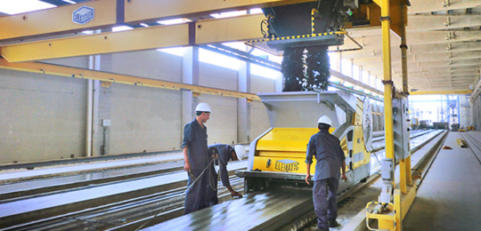
Ramy Labna | Construction Option
Analysis 1: Construction of Precast Vs. Cast in Place Concrete
2B + G + M + 7 Mansoura Development
OUTLINE
Project Background
Analysis 1: Construction Precast Vs. Cast in Place Concrete
Introduction
Design
Manufacturing & Quality
Delivery & Erection
Cost Impact
Schedule Impacts
Mechanical Breadth
Conclusions & Recommendations
Analysis 2: Comparison of Construction Practices between US & Qatar
Analysis 3: Field Labor Management & Alteration
Conclusion
Manufacturing
Offsite controlled working environment
Better efficiency due to repetitive process
Favorable working conditions
Less material wasted
Better safety practices
Quality
PCI Certified
Controlled air entrainment and cuing procedures
Better & more consistent quality of work
Photo Courtesy of www.atmiprecast.com
Photo Courtesy of www.concretetissues.com

Slide 9
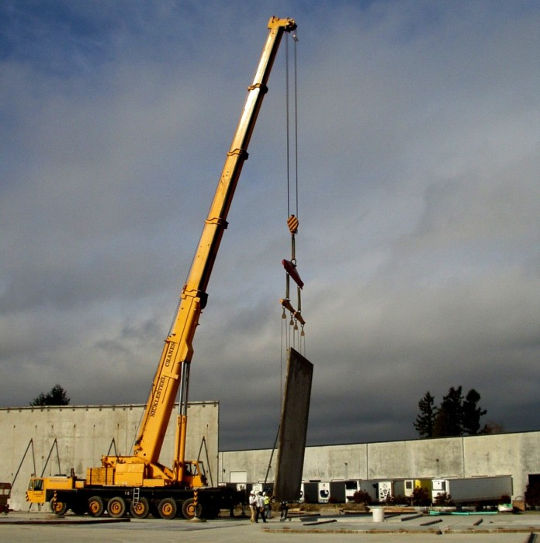
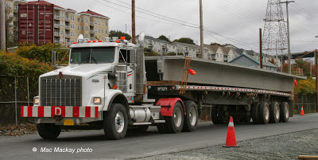
Ramy Labna | Construction Option
Analysis 1: Construction of Precast Vs. Cast in Place Concrete
2B + G + M + 7 Mansoura Development
OUTLINE
Project Background
Analysis 1: Construction Precast Vs. Cast in Place Concrete
Introduction
Design
Manufacturing & Quality
Delivery & Erection
Cost Impact
Schedule Impacts
Mechanical Breadth
Conclusions & Recommendations
Analysis 2: Comparison of Construction Practices between US & Qatar
Analysis 3: Field Labor Management & Alteration
Conclusion
Delivery
12’ x 50’ truck bed
Transported on non-staining, shock absorbing material
Manage ‘just-in-time’ deliveries
Delivery within 20-35 miles
Erection
Duration of erection reduced
40 ton lifting crane
1 floor erected per day
Photo Courtesy of www.truckfax.blogspot.com
Photo Courtesy of www.sicklesteelcranes.com

Slide 10
Ramy Labna | Construction Option
Analysis 1: Construction of Precast Vs. Cast in Place Concrete
2B + G + M + 7 Mansoura Development
Cost Comparison
Further detail can be seen in Appendix I in final report
OUTLINE
Project Background
Analysis 1: Construction Precast Vs. Cast in Place Concrete
Introduction
Design
Manufacturing & Quality
Delivery & Erection
Cost Impact
Schedule Impacts
Mechanical Breadth
Conclusions & Recommendations
Analysis 2: Comparison of Construction Practices between US & Qatar
Analysis 3: Field Labor Management & Alteration
Conclusion
Cast in Place Concrete
Price retrieved from RSMeans (Location factor: Philadelphia)
Cost includes Labor, Material & Erection
Cost: $550.50/CY
Precast Concrete Wall Panels
Price retrieved from Encon United Precast Company
Cost includes Material, Transportation, Insulation & Erection
Cost: $25/SF – without architectural finish
$30/SF – with architectural finish

Slide 11
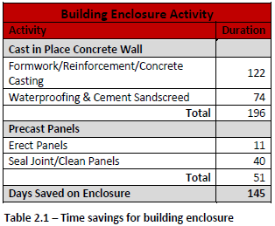
Ramy Labna | Construction Option
Analysis 1: Construction of Precast Vs. Cast in Place Concrete
2B + G + M + 7 Mansoura Development
OUTLINE
Project Background
Analysis 1: Construction Precast Vs. Cast in Place Concrete
Introduction
Design
Manufacturing & Quality
Delivery & Erection
Cost Impact
Schedule Impacts
Mechanical Breadth
Conclusions & Recommendations
Analysis 2: Comparison of Construction Practices between US & Qatar
Analysis 3: Field Labor Management & Alteration
Conclusion
Actual Savings
Superstructure completed on 17th Sept, 2014 (9 days ahead of schedule)
Minimum difference due to:
Sequencing and coordination of current schedule
Proposed Schedule Savings
Further detail can be seen in Appendix H for revised schedule

Slide 12
Ramy Labna | Construction Option
Analysis 1: Construction of Precast Vs. Cast in Place Concrete
2B + G + M + 7 Mansoura Development
OUTLINE
Project Background
Analysis 1: Construction Precast Vs. Cast in Place Concrete
Introduction
Design
Manufacturing & Quality
Delivery & Erection
Cost Impact
Schedule Impacts
Mechanical Breadth
Conclusions & Recommendations
Analysis 2: Comparison of Construction Practices between US & Qatar
Analysis 3: Field Labor Management & Alteration
Conclusion
R-Value Analysis
Performance of system in terms of Heating & Cooling
Thermal Properties
Affects users comfort level
Notes disparity of energy efficiency

Slide 13
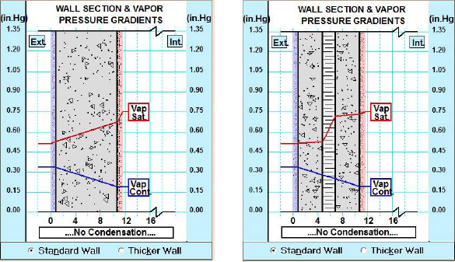
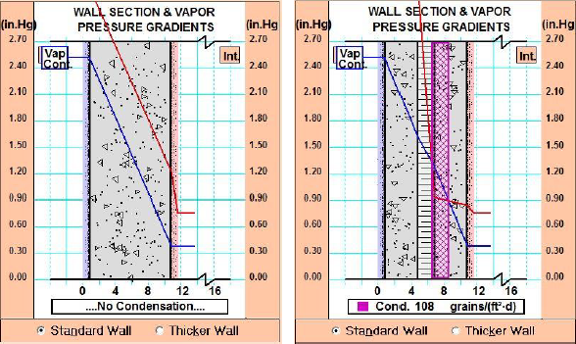
Ramy Labna | Construction Option
Analysis 1: Construction of Precast Vs. Cast in Place Concrete
2B + G + M + 7 Mansoura Development
OUTLINE
Project Background
Analysis 1: Construction Precast Vs. Cast in Place Concrete
Introduction
Design
Manufacturing & Quality
Delivery & Erection
Cost Impact
Schedule Impacts
Mechanical Breadth
Conclusions & Recommendations
Analysis 2: Comparison of Construction Practices between US & Qatar
Analysis 3: Field Labor Management & Alteration
Conclusion
Winter Condensation Analysis
Summer Condensation Analysis
Addition of Vapor Barrier - $4,024.44

Slide 14
Ramy Labna | Construction Option
Analysis 1: Construction of Precast Vs. Cast in Place Concrete
2B + G + M + 7 Mansoura Development
OUTLINE
Project Background
Analysis 1: Construction Precast Vs. Cast in Place Concrete
Introduction
Design
Manufacturing & Quality
Delivery & Erection
Cost Impact
Schedule Impacts
Mechanical Breadth
Conclusions & Recommendations
Analysis 2: Comparison of Construction Practices between US & Qatar
Analysis 3: Field Labor Management & Alteration
Conclusion
Conclusions
Accelerated Schedule by 9 days
Increase in Superstructure cost by $459,729
Better thermal properties using Precast
Recommendations
Resizing of Mechanical Equipment
Re-sequencing of activities
Use of Precast Concrete Wall Panels

Slide 15
Ramy Labna | Construction Option
Analysis 2: Comparison of Construction Practices
2B + G + M + 7 Mansoura Development
OUTLINE
Project Background
Analysis 1: Construction Precast Vs. Cast in Place Concrete
Analysis 2: Comparison of Construction Practices between US & Qatar
Introduction
Common Construction Practices in Qatar
Case Study: HHD Project (Penn State)
Comparison of Labor Wages
Comparison of Safety Programs
Comparison of Quality Control Programs
Conclusions & Recommendations
Analysis 3: Field Labor Management & Alteration
Conclusion
Opportunity Identification
Improvement of construction practices
Improve schedule
Reduce project cost
Improve overall quality
Potential Comparisons
Labor Wages
Safety Programs
Quality Control Programs

Slide 16
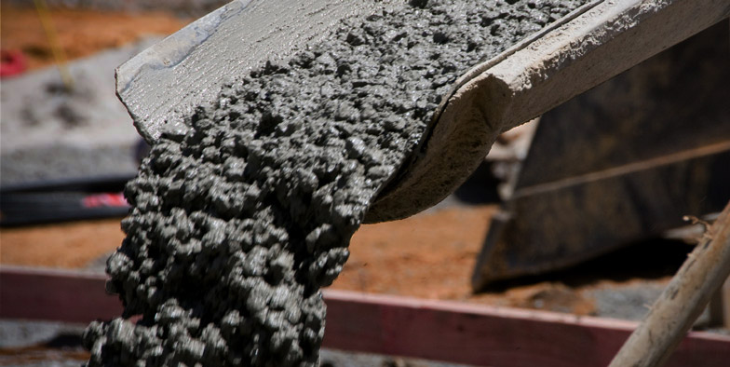
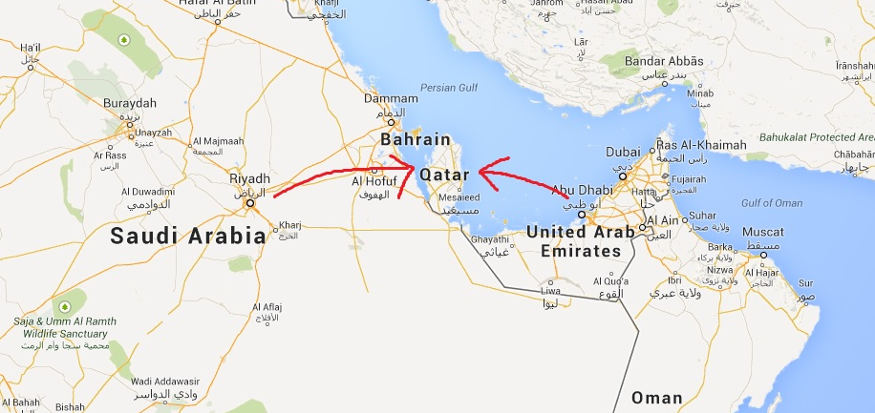
Ramy Labna | Construction Option
Analysis 2: Comparison of Construction Practices
2B + G + M + 7 Mansoura Development
OUTLINE
Project Background
Analysis 1: Construction Precast Vs. Cast in Place Concrete
Analysis 2: Comparison of Construction Practices between US & Qatar
Introduction
Common Construction Practices in Qatar
Case Study: HHD Project (Penn State)
Comparison of Labor Wages
Comparison of Safety Programs
Comparison of Quality Control Programs
Conclusions & Recommendations
Analysis 3: Field Labor Management & Alteration
Conclusion
Cast in Place Construction
Cheaper
Material readily available
Material/Resource Availability
Shipped from neighboring countries
No natural resources
Special material delivery can be timely process
Photo Courtesy of www.allsortsconcrete.com
Photo Courtesy of Google Maps

Slide 17
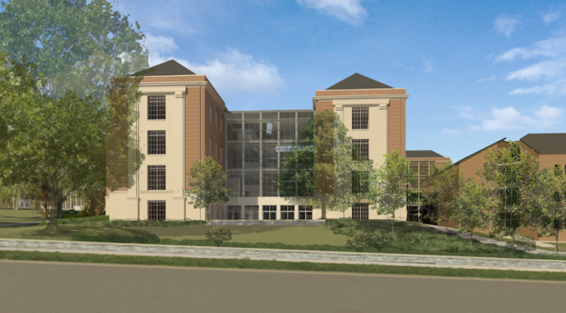
Ramy Labna | Construction Option
Analysis 2: Comparison of Construction Practices
2B + G + M + 7 Mansoura Development
OUTLINE
Project Background
Analysis 1: Construction Precast Vs. Cast in Place Concrete
Analysis 2: Comparison of Construction Practices between US & Qatar
Introduction
Common Construction Practices in Qatar
Case Study: HHD Project (Penn State)
Comparison of Labor Wages
Comparison of Safety Programs
Comparison of Quality Control Programs
Conclusions & Recommendations
Analysis 3: Field Labor Management & Alteration
Conclusion
Human Health Development (HHD) Project
Academic/Research building
93,000 SF of new construction
Anticipated completion by Spring 2015
Multiple Prime Contract
Photo Courtesy of www.opp.psu.edu

Slide 18
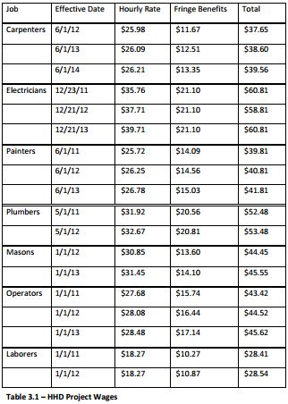
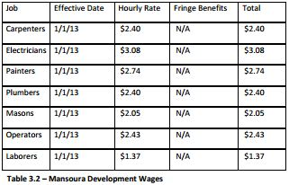
Ramy Labna | Construction Option
Analysis 2: Comparison of Construction Practices
2B + G + M + 7 Mansoura Development
OUTLINE
Project Background
Analysis 1: Construction Precast Vs. Cast in Place Concrete
Analysis 2: Comparison of Construction Practices between US & Qatar
Introduction
Common Construction Practices in Qatar
Case Study: HHD Project (Penn State)
Comparison of Labor Wages
Comparison of Safety Programs
Comparison of Quality Control Programs
Conclusions & Recommendations
Analysis 3: Field Labor Management & Alteration
Conclusion
HHD Project
State funded job
State prevailing wage rate
Mansoura Development
No minimum wage rate
Free medical service
Unskilled workers – negative impact to project
Notes:
As you can Qatar is much more cheaper due to having no minimum wage, free medical service and large availability of unskilled workers. This however can negatively affect the jobsite due to the workers lack of knowledge.
In comparison to the US which is ___% more

Slide 19
Ramy Labna | Construction Option
Analysis 2: Comparison of Construction Practices
2B + G + M + 7 Mansoura Development
OUTLINE
Project Background
Analysis 1: Construction Precast Vs. Cast in Place Concrete
Analysis 2: Comparison of Construction Practices between US & Qatar
Introduction
Common Construction Practices in Qatar
Case Study: HHD Project (Penn State)
Comparison of Labor Wages
Comparison of Safety Programs
Comparison of Quality Control Programs
Conclusions & Recommendations
Analysis 3: Field Labor Management & Alteration
Conclusion
HHD Project
All contractors have OSHA 30 – Safety Course
Daily Meetings to highlight safety issues
Safety toolbox topics meeting – Once a week
Zero Recordable accidents
Mansoura Development
No safety administration (like OSHA) in Qatar
Abide by company own Health & Safety Policy
4 Step safety program:
Make regular job site inspections
Enforce use of safety equipment
Follow safety procedures
Provide on-going safety training
Suspension of pay if rules not followed
8 recordable injuries as of yet
Notes:
US prove to have much stricter safety standards than Qatar, which is why HHD has 0 recordable accidents compared to Mansoura's 8.
Qatar does not have a safety administration such as OSHA this can result in lack of safety in the actual jobsite, resulting in extra costs and schedule delays.

Slide 20
Ramy Labna | Construction Option
Analysis 2: Comparison of Construction Practices
2B + G + M + 7 Mansoura Development
OUTLINE
Project Background
Analysis 1: Construction Precast Vs. Cast in Place Concrete
Analysis 2: Comparison of Construction Practices between US & Qatar
Introduction
Common Construction Practices in Qatar
Case Study: HHD Project (Penn State)
Comparison of Labor Wages
Comparison of Safety Programs
Comparison of Quality Control Programs
Conclusions & Recommendations
Analysis 3: Field Labor Management & Alteration
Conclusion
HHD Project
Three-Phase Control System:
Preparatory Phase
Initial Phase
Follow-Up Phase
Lifetime of Building – 100 years
Mansoura Development
No actual program followed
Engineer on site check current work
Lifetime of Building – 50-70 years
Notes:
Rather than have a three phase QC program much like the HHD project, the Mansoura development they have an engineer on site to check the work, which isnt very proficient.
Not having a QC program can negatively impact the quality of the building and result in many problems along the future.

Slide 21
Ramy Labna | Construction Option
Analysis 2: Comparison of Construction Practices
2B + G + M + 7 Mansoura Development
OUTLINE
Project Background
Analysis 1: Construction Precast Vs. Cast in Place Concrete
Analysis 2: Comparison of Construction Practices between US & Qatar
Introduction
Common Construction Practices in Qatar
Case Study: HHD Project (Penn State)
Comparison of Labor Wages
Comparison of Safety Programs
Comparison of Quality Control Programs
Conclusions & Recommendations
Analysis 3: Field Labor Management & Alteration
Conclusion
Conclusions
Potential to cut down on project costs
Potential delivery of project on or before time
Huge potential to improve safety of construction site
Recommendations
Acquire/Train more experienced workers
OSHA trained personnel on site
Regular unscheduled site safety inspections
Implement Quality Control program similar to HHD Project

Slide 22
Ramy Labna | Construction Option
Analysis 3: Field Labor Management & Alteration
2B + G + M + 7 Mansoura Development
OUTLINE
Project Background
Analysis 1: Construction Precast Vs. Cast in Place Concrete
Analysis 2: Comparison of Construction Practices between US & Qatar
Analysis 3: Field Labor Management & Alteration
Introduction
Evaluate Current Schedule
Labor Increase
SIPS Analysis
Man Power Loaded Schedule
Conclusions & Recommendations
Conclusion
Problem Identification
Immense heat of summer months (Over 122 degrees)
Government halts construction during the day
Delays in schedule
Potential Solutions
Re-evaluate/Re-sequence activities in schedule
Increasing labor force pre-summer months
SIPS implementation of superstructure
Man Power Loaded schedule
Notes:
Consists of finding ways to by pass the halt of construction which is implemented during the summer months where temp can rise over 122 degrees.

Slide 23
Ramy Labna | Construction Option
Analysis 3: Field Labor Management & Alteration
2B + G + M + 7 Mansoura Development
OUTLINE
Project Background
Analysis 1: Construction Precast Vs. Cast in Place Concrete
Analysis 2: Comparison of Construction Practices between US & Qatar
Analysis 3: Field Labor Management & Alteration
Introduction
Evaluate Current Schedule
Labor Increase
SIPS Analysis
Man Power Loaded Schedule
Conclusions & Recommendations
Conclusion
Current Schedule
Superstructure construction goes through summer
Floor by floor phasing
*See Appendix E for current project schedule
Possible Solutions
Completion of Superstructure before July, 2014
Phasing construction by trade
Increase man power for superstructure completion

Slide 24
Ramy Labna | Construction Option
Analysis 3: Field Labor Management & Alteration
2B + G + M + 7 Mansoura Development
OUTLINE
Project Background
Analysis 1: Construction Precast Vs. Cast in Place Concrete
Analysis 2: Comparison of Construction Practices between US & Qatar
Analysis 3: Field Labor Management & Alteration
Introduction
Evaluate Current Schedule
Labor Increase
SIPS Analysis
Man Power Loaded Schedule
Conclusions & Recommendations
Conclusion
Cost Analysis
$1.37 – Labor Cost
13 extra laborers added
Overall reduction: $22,906.40

Slide 25
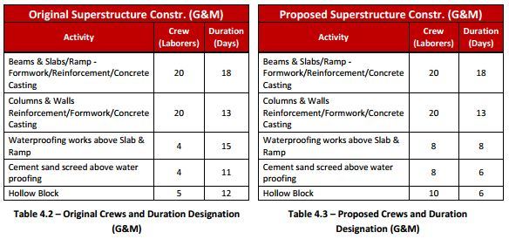
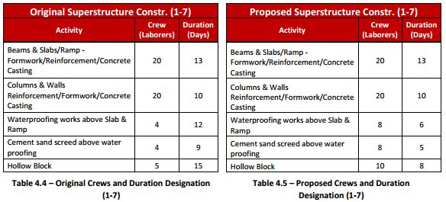
Ramy Labna | Construction Option
Analysis 3: Field Labor Management & Alteration
2B + G + M + 7 Mansoura Development
OUTLINE
Project Background
Analysis 1: Construction Precast Vs. Cast in Place Concrete
Analysis 2: Comparison of Construction Practices between US & Qatar
Analysis 3: Field Labor Management & Alteration
Introduction
Evaluate Current Schedule
Labor Increase
SIPS Analysis
Man Power Loaded Schedule
Conclusions & Recommendations
Conclusion
SIPS
Implementation on superstructure (Concrete Casting)
5 activities per floor
Construction start: 26th August, 2013
Ground & Mezzanine floors – 9900 GSF
Floors 1-7 – 7900 GSF

Slide 26
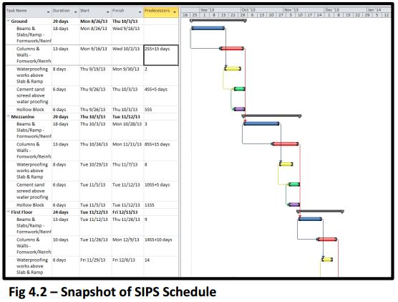
Ramy Labna | Construction Option
Analysis 3: Field Labor Management & Alteration
2B + G + M + 7 Mansoura Development
OUTLINE
Project Background
Analysis 1: Construction Precast Vs. Cast in Place Concrete
Analysis 2: Comparison of Construction Practices between US & Qatar
Analysis 3: Field Labor Management & Alteration
Introduction
Evaluate Current Schedule
Labor Increase
SIPS Analysis
Man Power Loaded Schedule
Conclusions & Recommendations
Conclusion
*See Appendix L for Full version of SIPS Schedule
Schedule Reduction
New finish date: 30th May, 2014
120 Days ahead of schedule
27th Sept, 2014

Slide 27
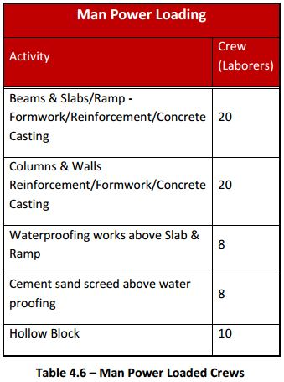
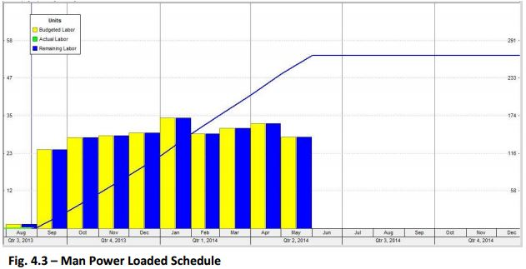
Ramy Labna | Construction Option
Analysis 3: Field Labor Management & Alteration
2B + G + M + 7 Mansoura Development
OUTLINE
Project Background
Analysis 1: Construction Precast Vs. Cast in Place Concrete
Analysis 2: Comparison of Construction Practices between US & Qatar
Analysis 3: Field Labor Management & Alteration
Introduction
Evaluate Current Schedule
Labor Increase
SIPS Analysis
Man Power Loaded Schedule
Conclusions & Recommendations
Conclusion
Man Power Loaded Schedule
Based on SIPS Schedule
Ensures SIPS feasibility
Over-allocation of Laborers

Slide 28
Ramy Labna | Construction Option
Analysis 3: Field Labor Management & Alteration
2B + G + M + 7 Mansoura Development
Conclusions
Superstructure schedule reduced by 120 days
By-pass halt in construction
Promotion of safer site
Recommendations
Implement SIPS over original schedule
Further consideration to apply SIPS on all trades
OUTLINE
Project Background
Analysis 1: Construction Precast Vs. Cast in Place Concrete
Analysis 2: Comparison of Construction Practices between US & Qatar
Analysis 3: Field Labor Management & Alteration
Introduction
Evaluate Current Schedule
Labor Increase
SIPS Analysis
Man Power Loaded Schedule
Conclusions & Recommendations
Conclusion

Slide 29
Ramy Labna | Construction Option
Conclusion
2B + G + M + 7 Mansoura Development
OUTLINE
Project Background
Analysis 1: Construction Precast Vs. Cast in Place Concrete
Analysis 2: Comparison of Construction Practices between US & Qatar
Analysis 3: Field Labor Management & Alteration
Conclusion
Analysis 1 | Precast Vs. Cast in Place
Accelerates schedule by 9 days
Increases cost by $459,729
Conclusion
Schedule acceleration primary concern for owner
Potential in resizing of Mechanical equipment
Potential schedule accelerations through re-sequencing of activities for Precast
Analysis 2 | Comparison of Construction Practices between US & Qatar
Increase in skilled workers
Introduction to OSHA personnel
Implementation of Quality Control Program
Analysis 3 | Field Labor Management & Alteration
Decreases labor cost by $22,906.40
Accelerates superstructure schedule by 120 days

Slide 30
Ramy Labna | Construction Option
Acknowledgements
2B + G + M + 7 Mansoura Development
OUTLINE
Project Background
Analysis 1: Construction Precast Vs. Cast in Place Concrete
Analysis 2: Comparison of Construction Practices between US & Qatar
Analysis 3: Field Labor Management & Alteration
Conclusion
THANKS!
Special Thanks
Petra Design – Mahmoud El-Salti
Commitment Construction Project Team
John Bechtel
My Family & Friends
Academic Acknowledgements
Prof. Ray Sowers – CM Faculty Advisor
Dr. Craig Dubler
Dr. Robert Leicht
Dr. John Messner
Penn State AE Faculty
Industry Acknowledgements

